Slide 1

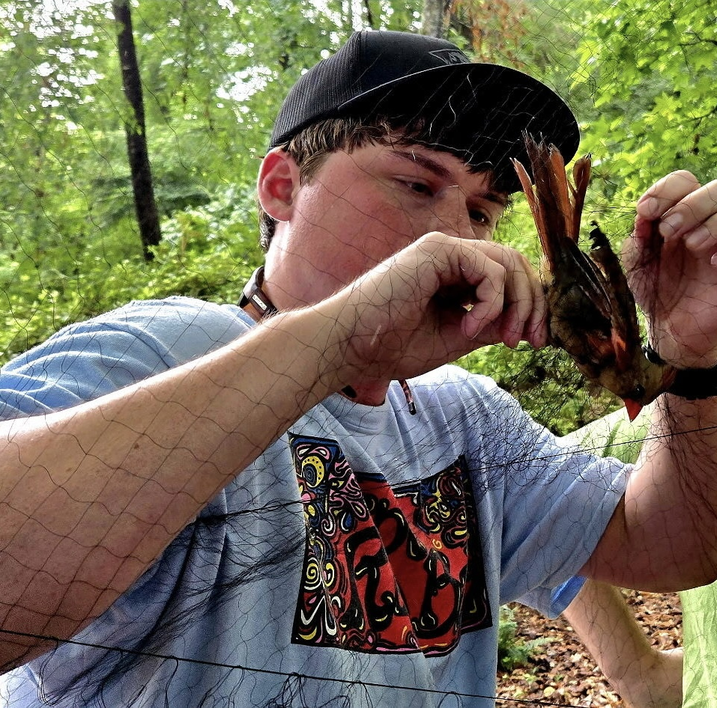
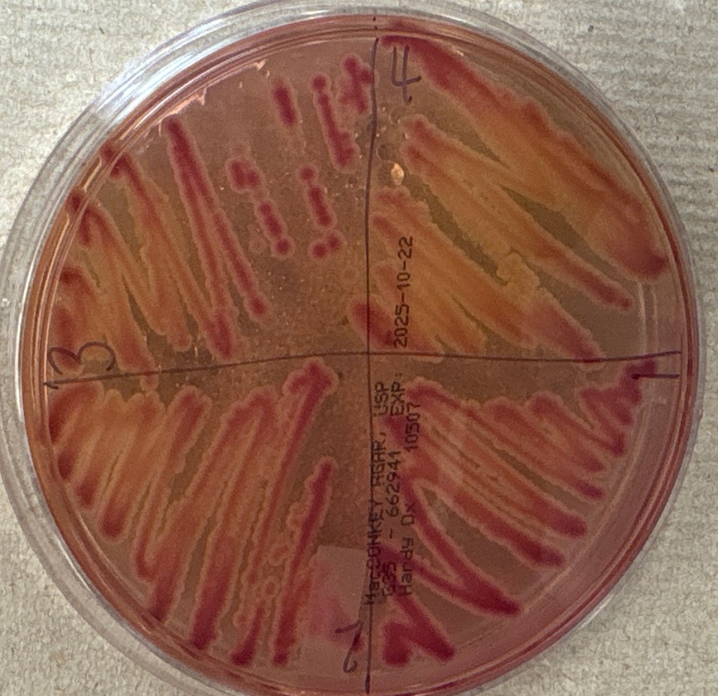
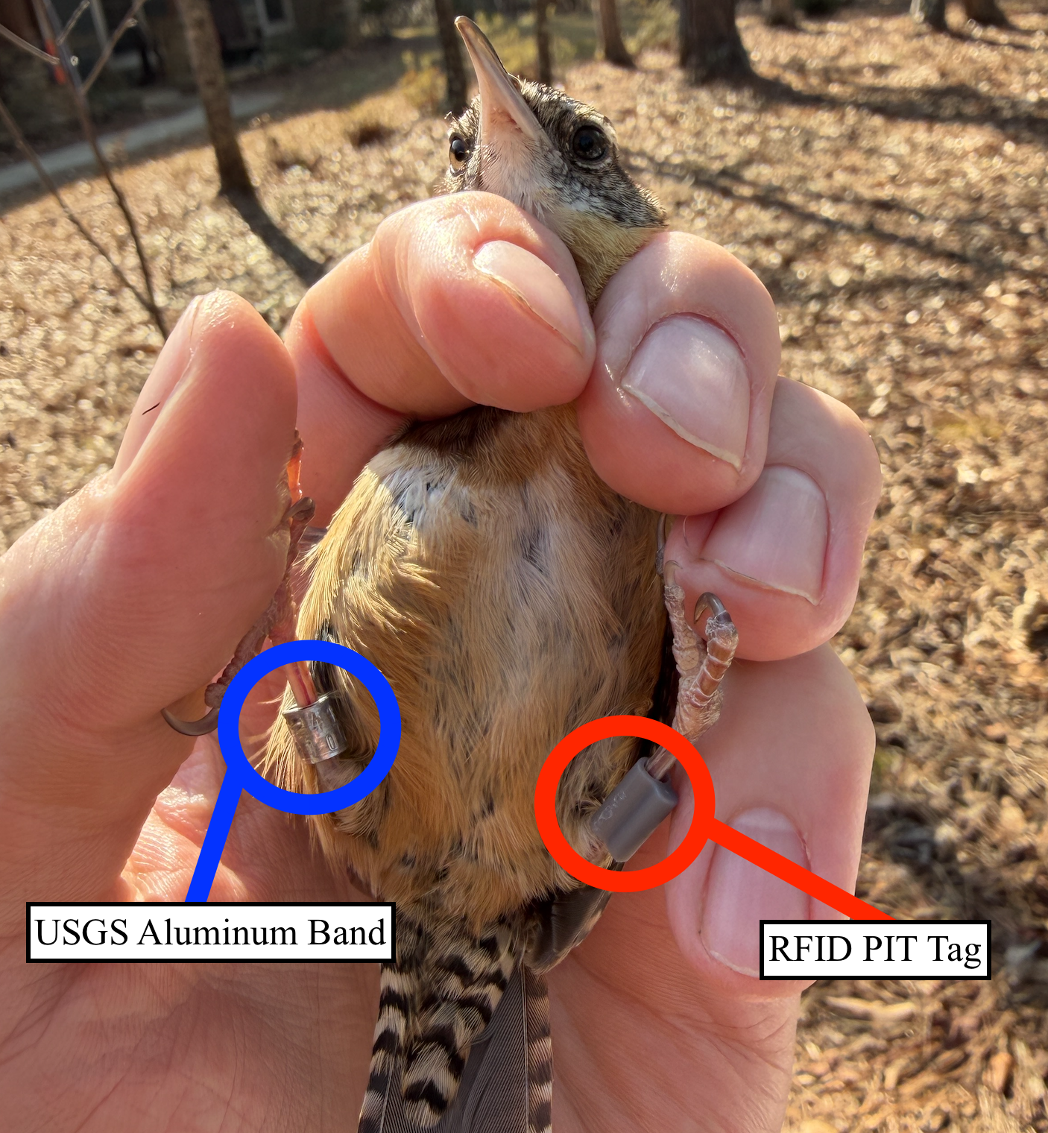
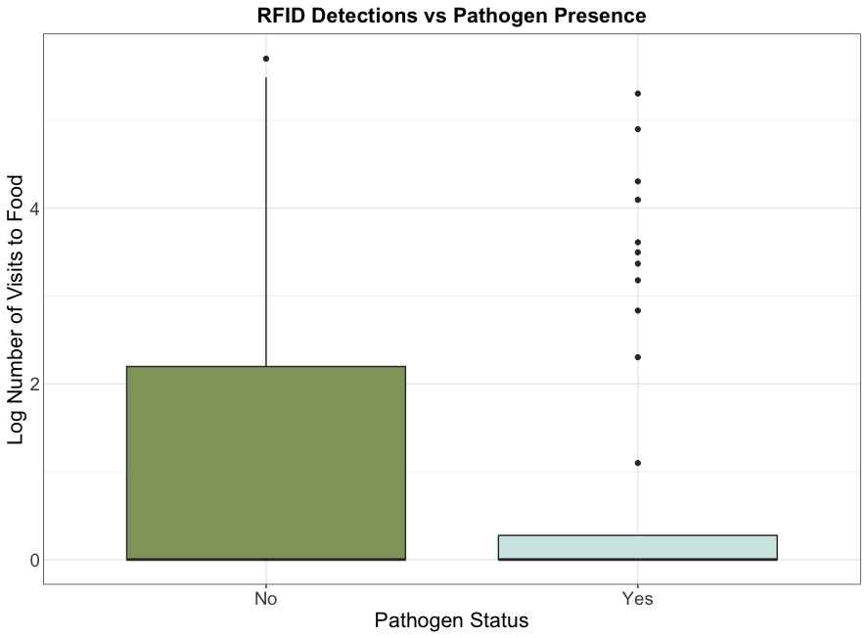
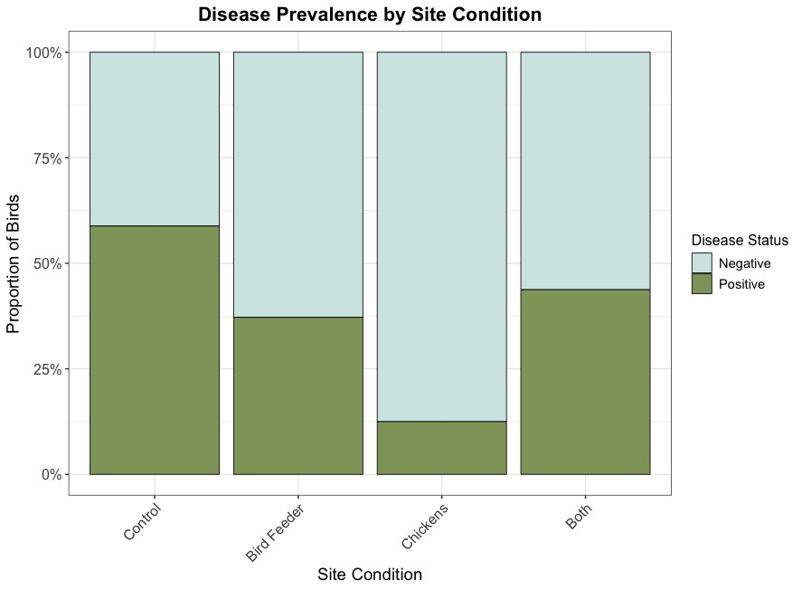
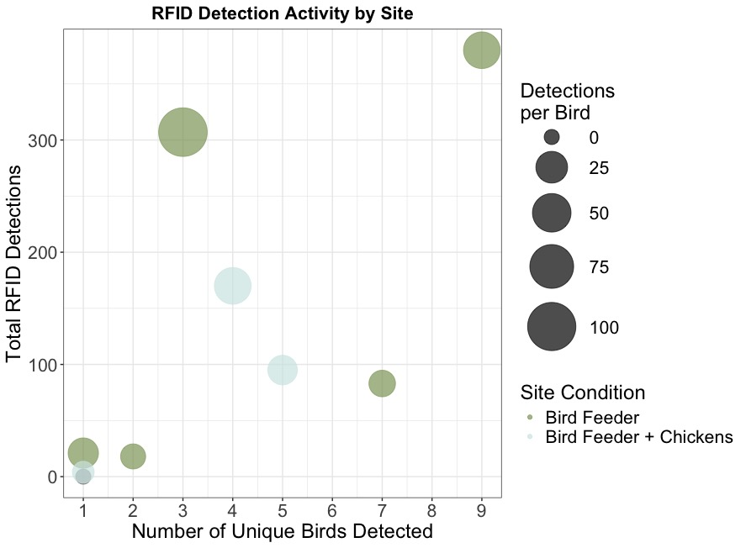
Backyard Birds & Disease: Pathogen Transmission at the Human Wildlife Interface
Alex Fisher¹, Grace Southerland¹, Luke Watters¹, Aniruddha Belsare ^{1,2}, Kelsey McCune¹
¹College of Forestry, Wildlife and Environment, Auburn University
²Auburn University College of Veterinary Medicine
Background
Experimental Design
Conclusions
Bird feeding & poultry keeping are widespread in the US
Bird feeders increase contact rates and contamination of food, water, & surfaces.
Backyard chickens can be reservoirs for bacteria like Salmonella enterica
> 70% of diseases are zoonotic - originating in wildlife and capable of spreading to other species
We do not know the combined effects of feeders & poultry on disease in wild birds
12 study sites sampled monthly in central Alabama along an urban-to-rural gradient (June 2024–2027)
Four treatment types:
Control sites (no feeders/poultry): n = 4
Bird feeders only: n = 4
Backyard chickens only: n = 2
Both feeders and chickens: n = 2
Field Sampling
Wild songbirds captured using mist nets
>230 birds captured to date
Common resident species receive PIT tags to track feeder visitation via RFID antennas
Collected wild bird & chicken fecal samples (cloacal swabs or fresh droppings)
Laboratory Analysis - Samples cultured for bacterial pathogens
The presence of supplemental feed may suggest an association with reduced bacterial infections in wild birds
In the future we hope to:
  Expand sampling at chicken-keeping households to increase statistical power
  Optimize RFID detection at control and chicken-only sites
  Develop evidence-based biosecurity guidelines for backyard practices
This study investigates how feeders and backyard poultry influence disease transmission in wild birds.
Aim 1: Test relationship between food visitation frequency and pathogen prevalence using RFID data
Aim 2: Compare pathogen prevalence among different site types
Images
Mist Net Extraction
Plate with Positive Bacterial Growth
Captured Bird with USGS Band & RFID Tags
Results
p > 0.05
p = 0.86
p > 0.05
p = 0.05
p = 0.017
Acknowledgements
References and Contact Information

